Slide 1
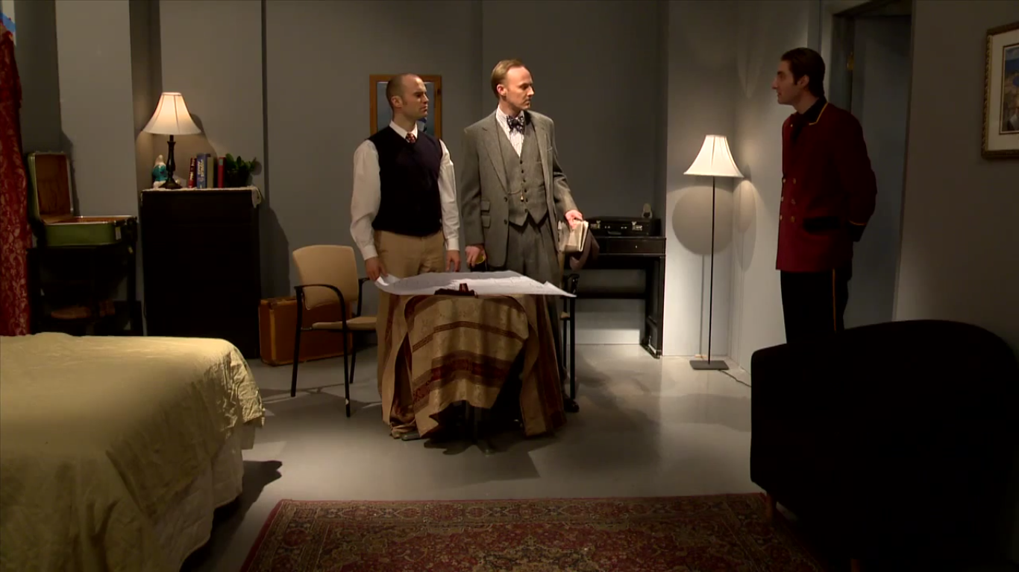

THE STILL ALARM
Discussing the lighthearted and comical tone set in The Still Alarm to showcase the stereotypes of English men.
An IOP by See Tow Shiun Hou (21), 3.11

Slide 2
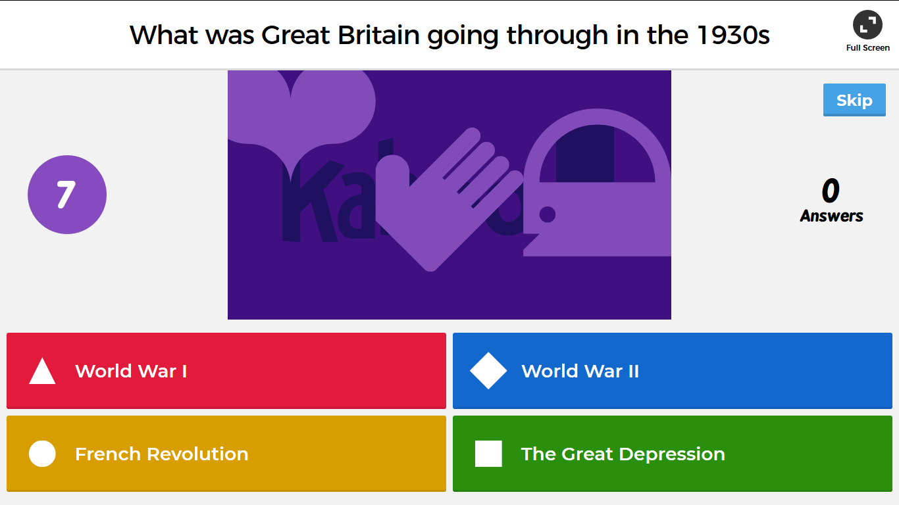
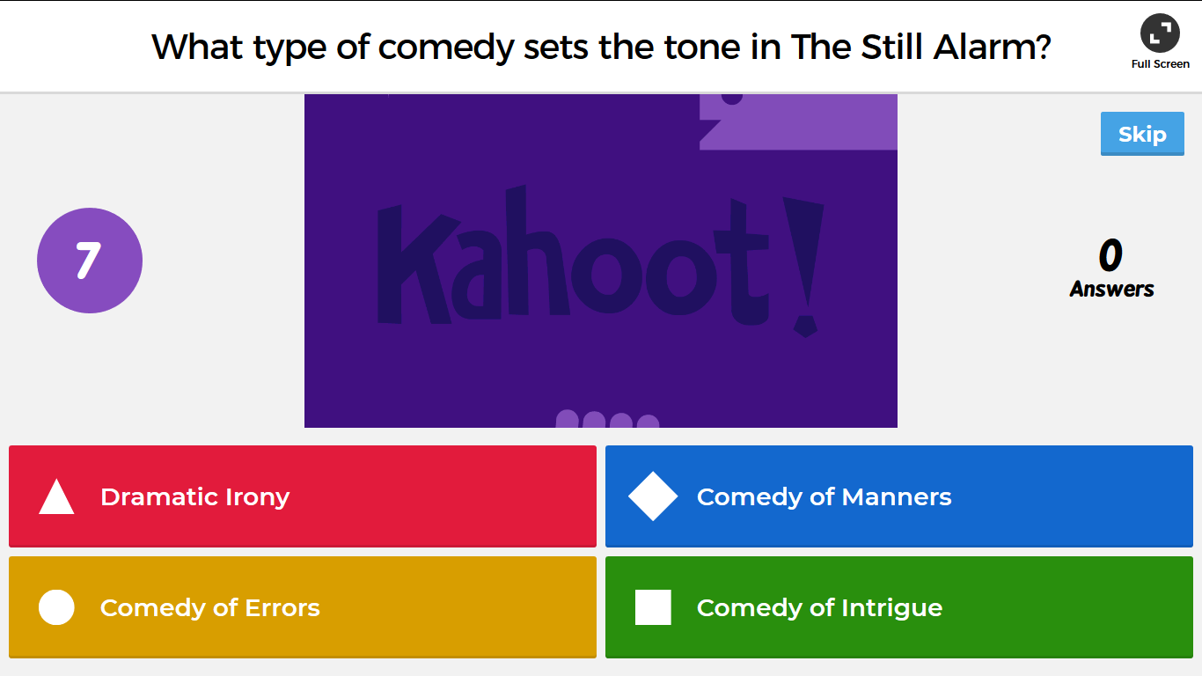
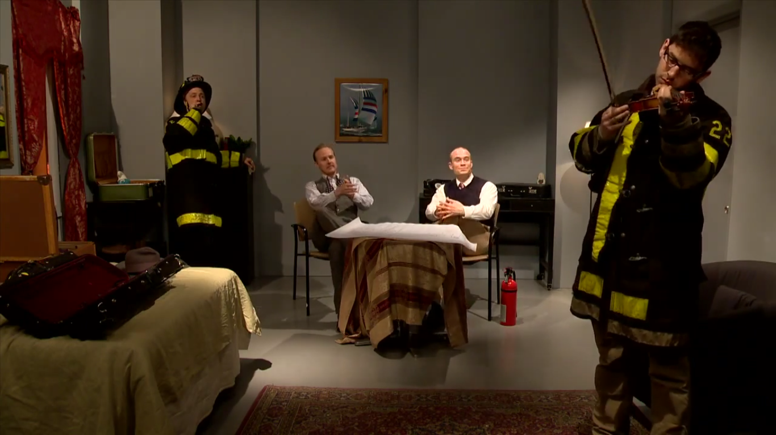
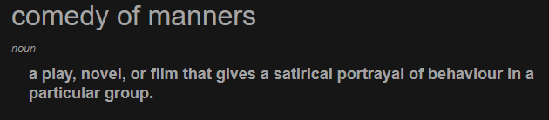
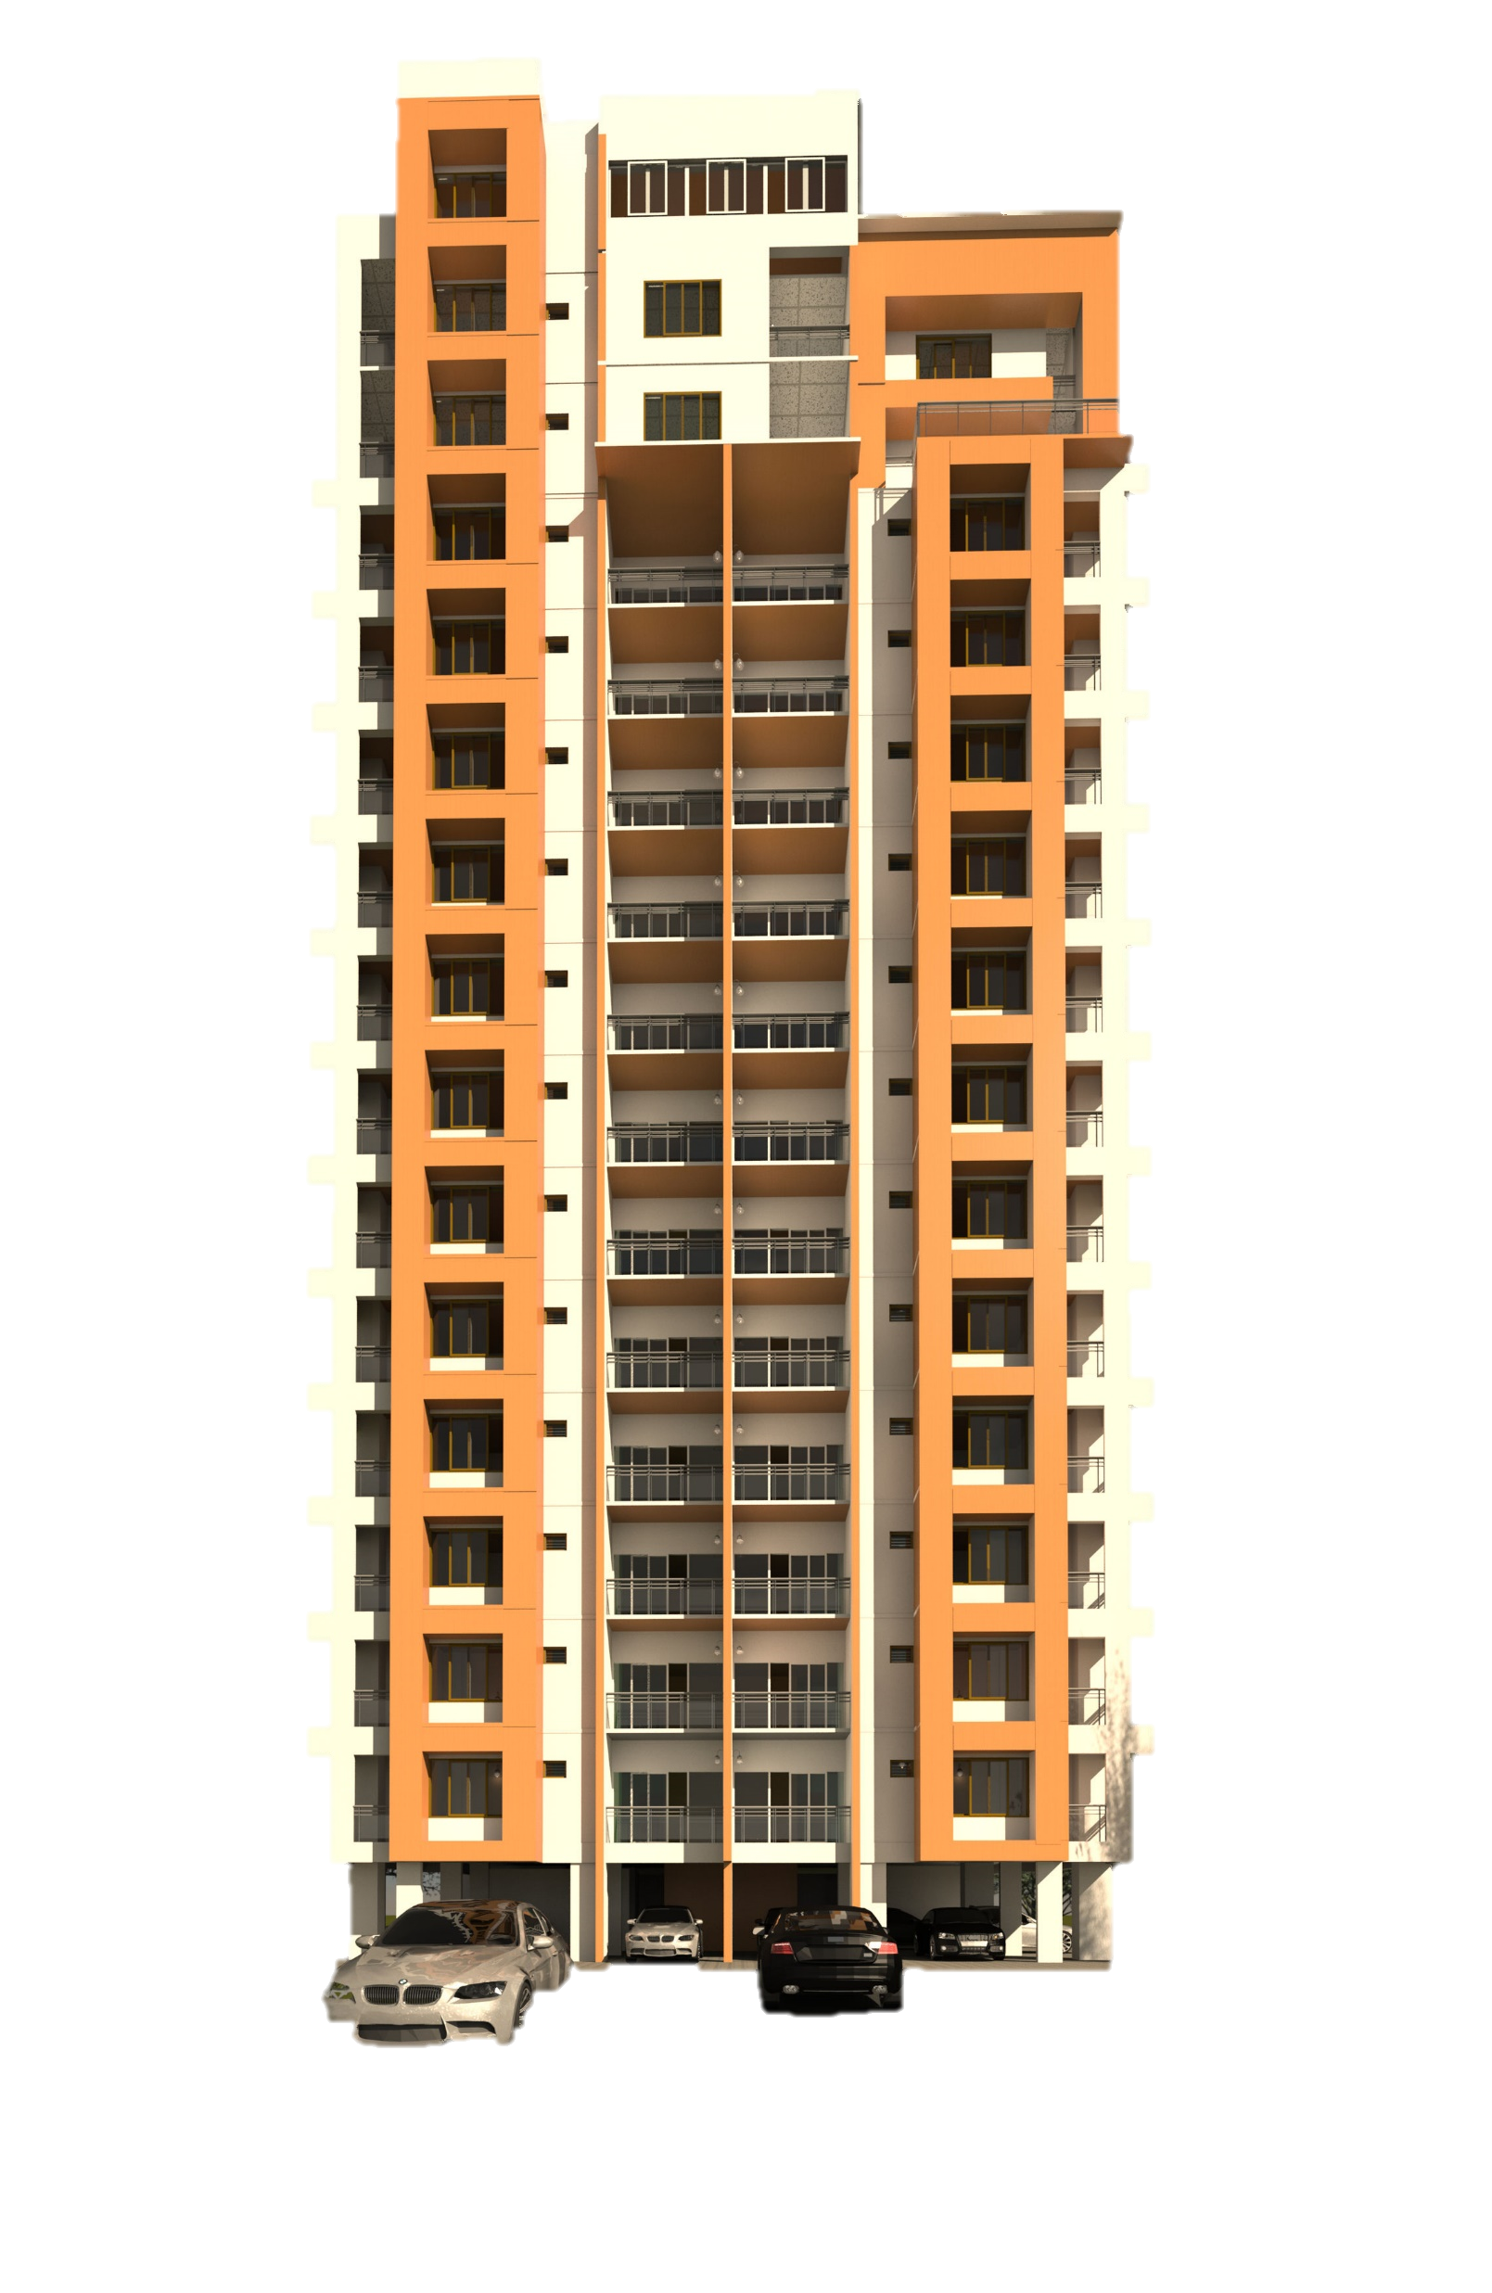
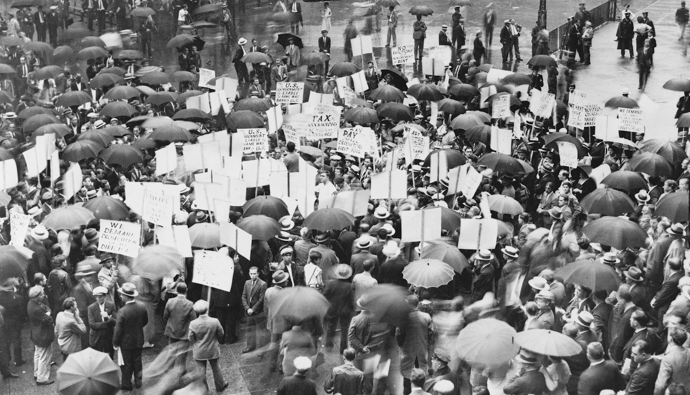
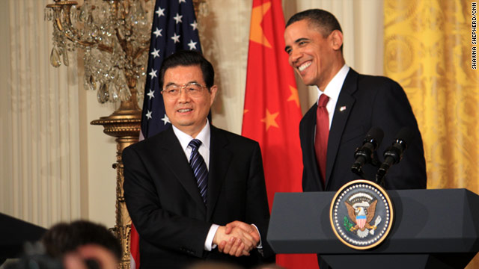
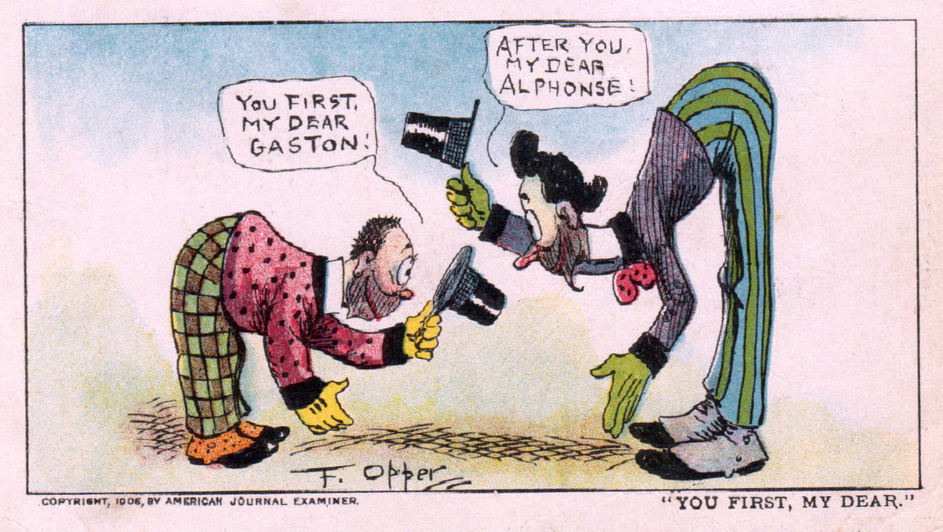
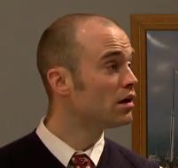

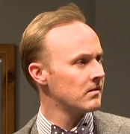
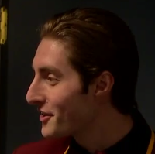

Obviously
Have they notified the fire department? Well, that’s the thing to do…
The lower half of the hotel is just about gone, sir
Obviously

Slide 3
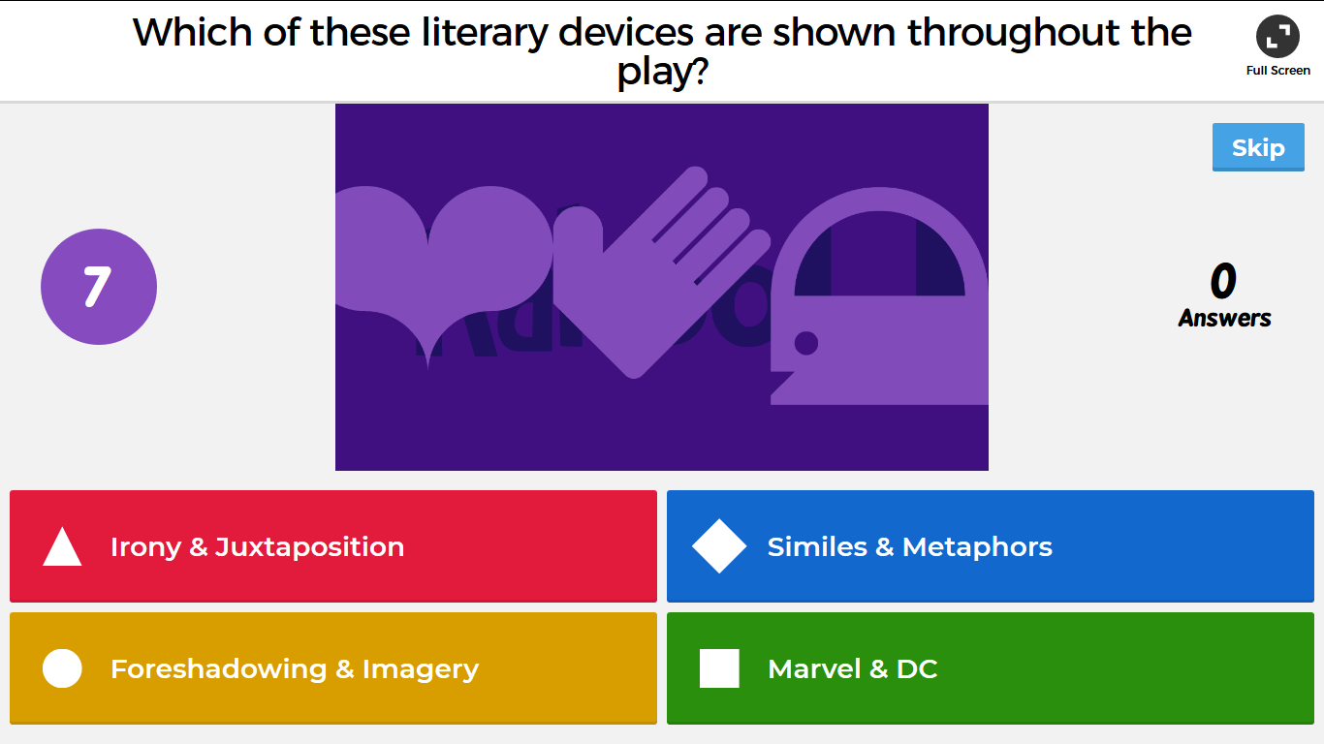
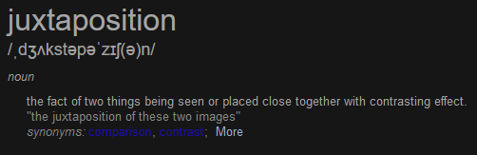
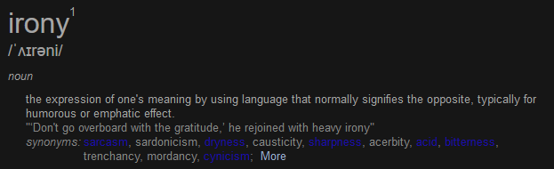
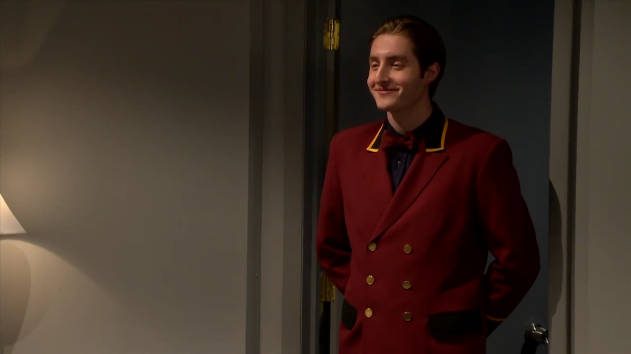
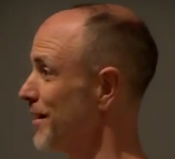
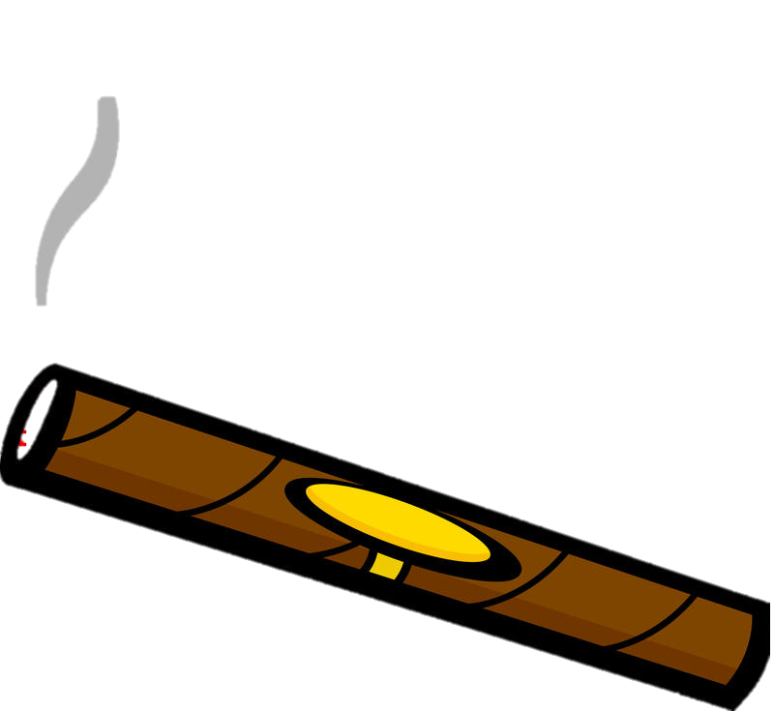
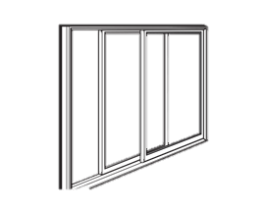
You know, if I move to another hotel, I’ll never get my mail.
Concerned about the nitty-gritty while ignoring the bigger picture
Well, I guess you boys want to get to work, don’t you
Suppose I go to another hotel and there’s a fire there, too!
The wall will go pretty soon, but don’t worry, it will fall the other way.
If you don’t mind, we’d like to spray around for a bit
Ridiculous Responses
It’s getting stuffy in this room, too. Phew! (gets phone) Hello – ice water in eleven-eighteen!
Mocking the orderliness of conversational exchanges

Slide 4
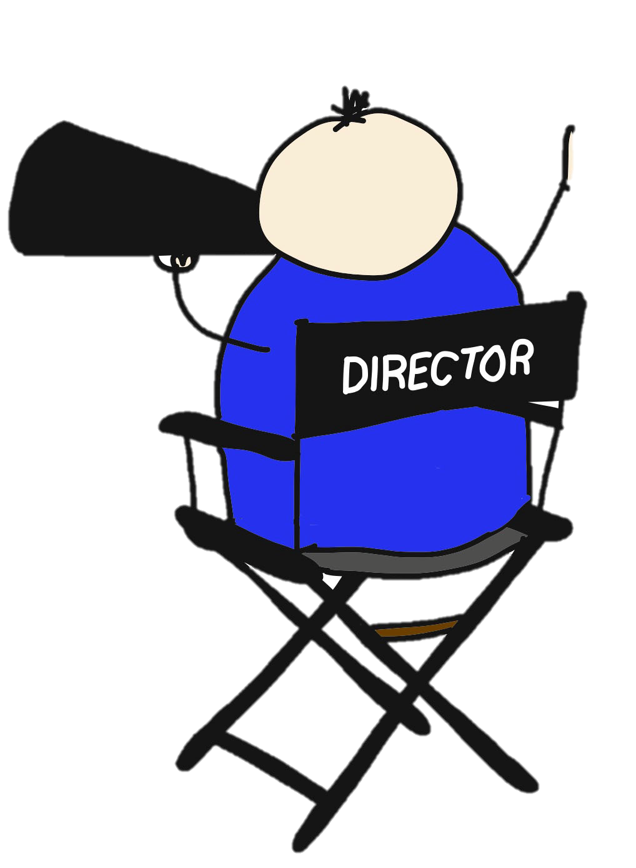
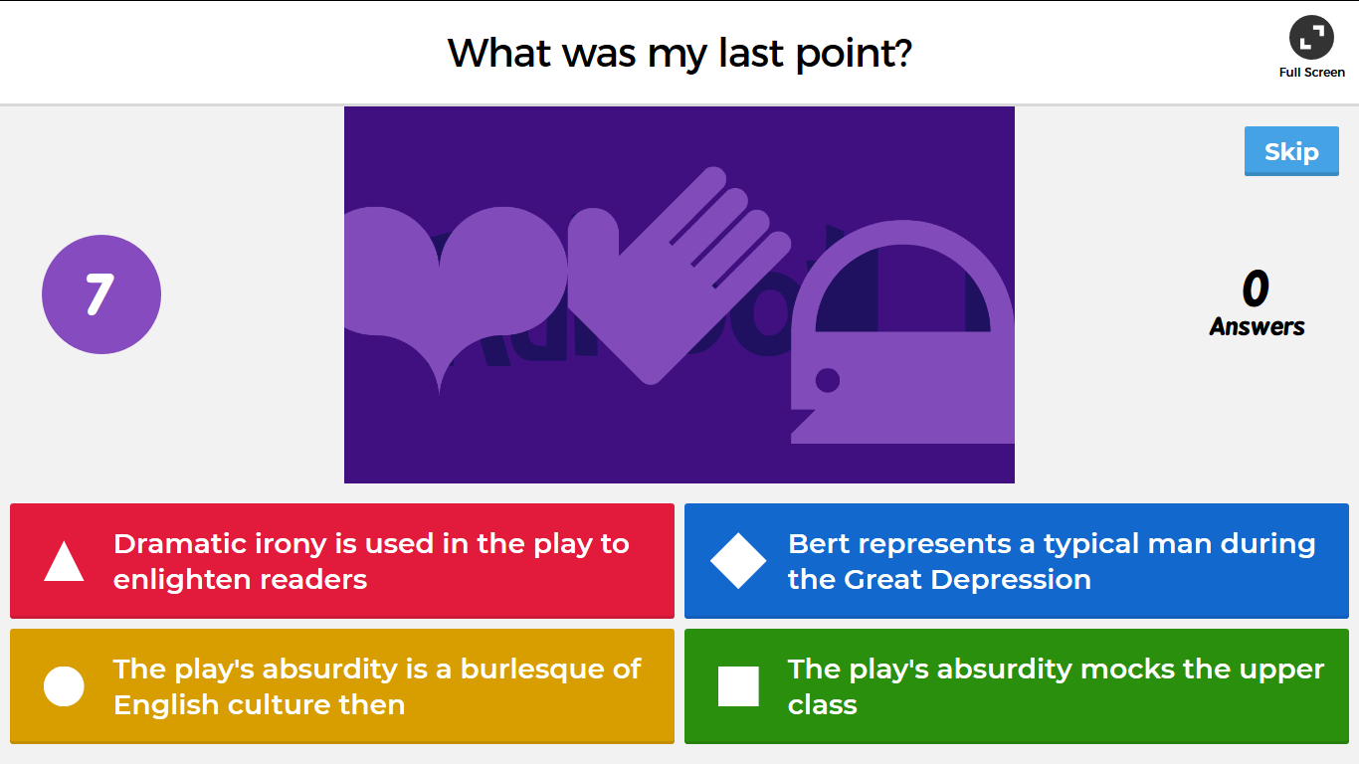
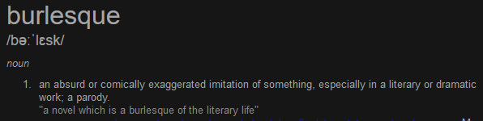
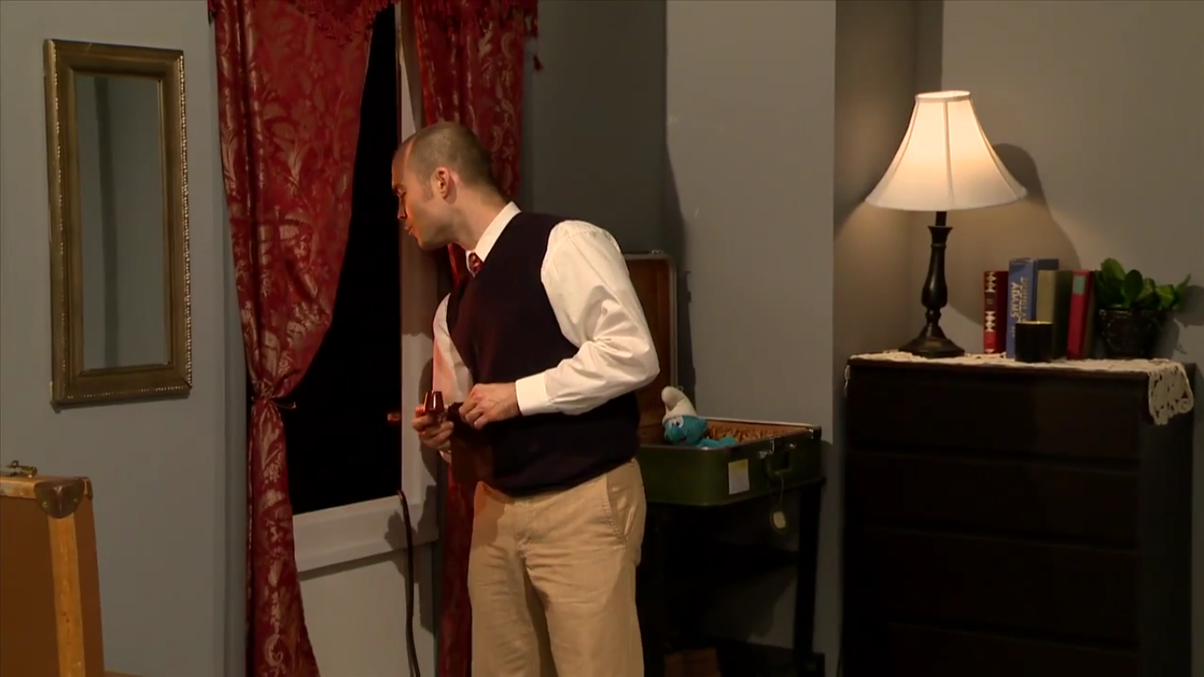
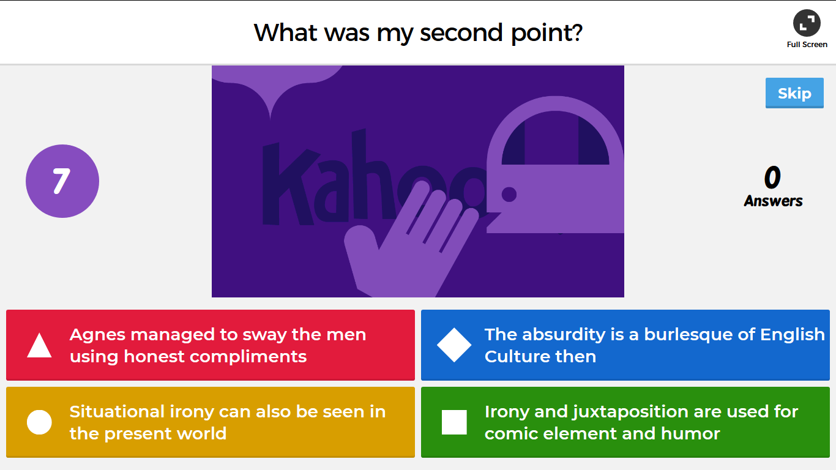
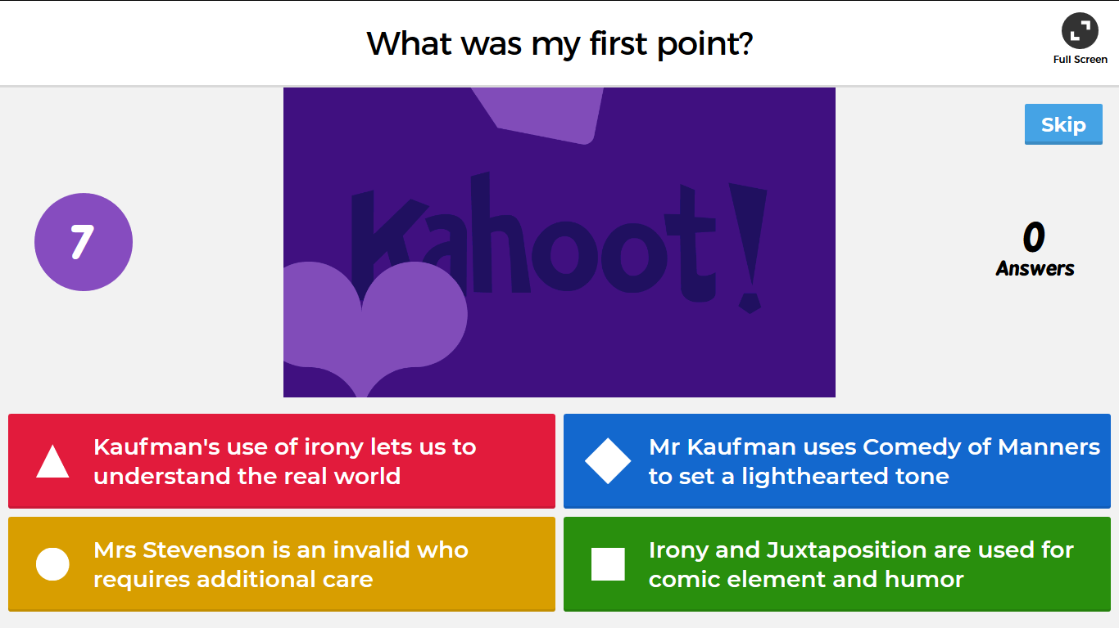
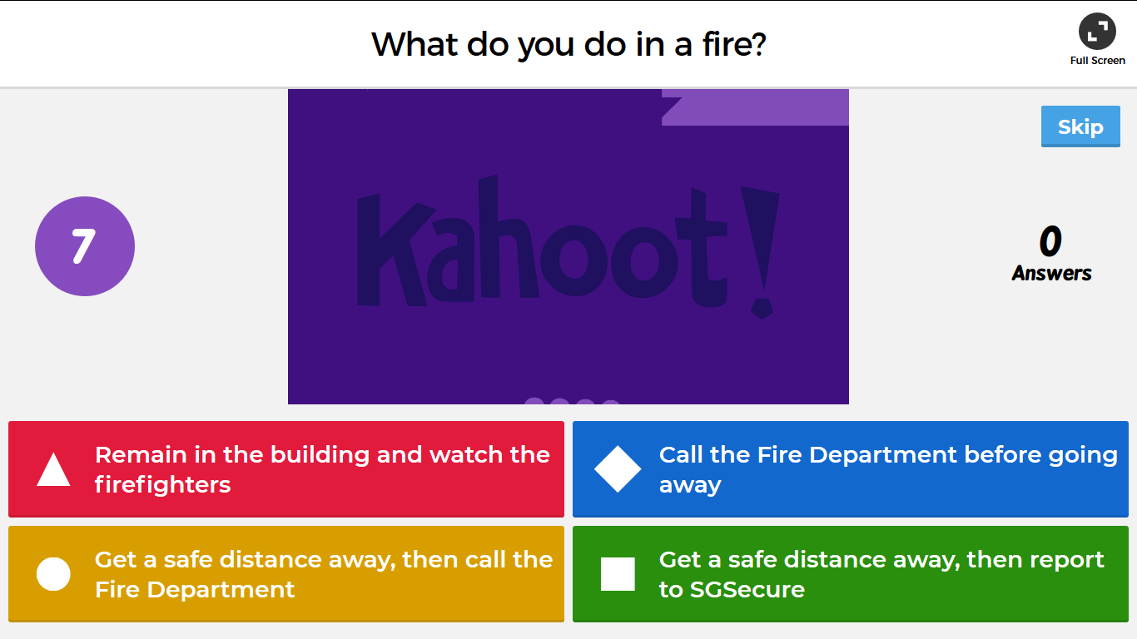
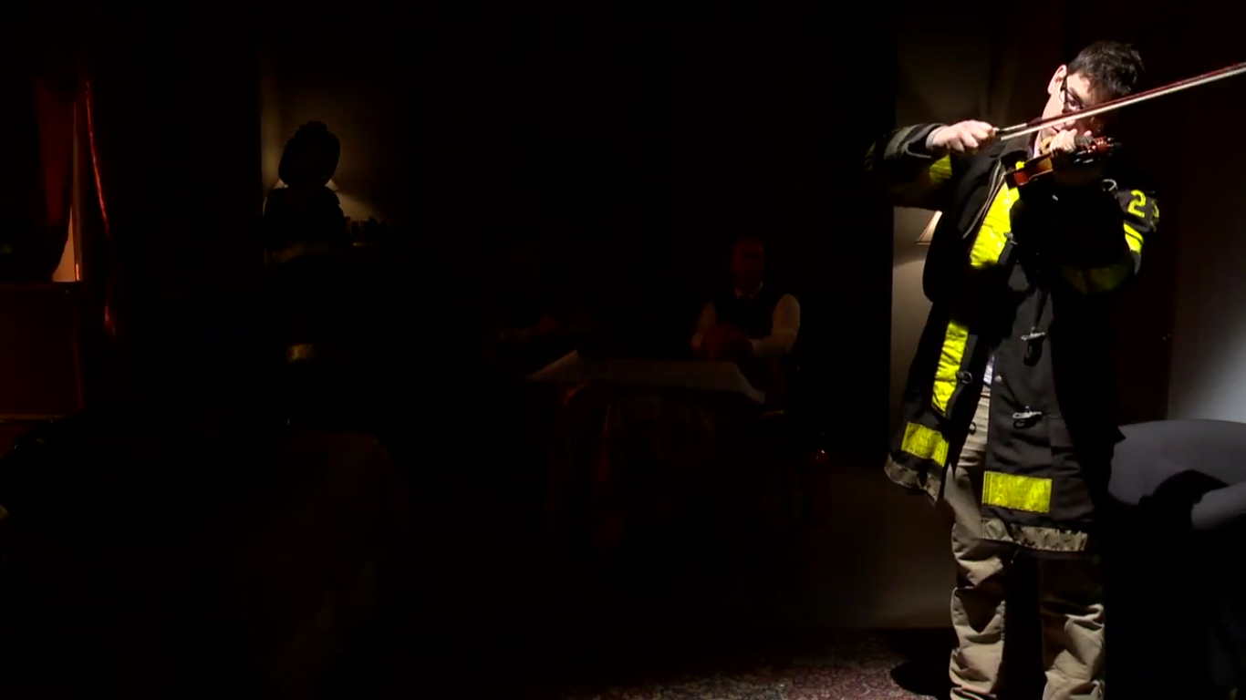
The second fireman takes centre stage, with all the manner of a concert violinist
…entire play should be acted calmly and politely,
Going to window
…manner of English drawing room comedy. No actor ever raises his voice.
How is it? No better?
Worse, if any. It’ll be up here in a few moments.
Keep The Home Fires Burning

Slide 5


References & Bibliography
Alphonse and Gaston. (2018, March 27). Retrieved April 1, 2018, from https://en.wikipedia.org/wiki/Alphonse_and_Gaston
The Still Alarm. (2018, March 28). Retrieved April 1, 2018, from https://en.wikipedia.org/wiki/The_Still_Alarm
Mr. Obama and Mr. Hu on Warming. (2009, September 23). Retrieved April 1, 2018, from https://www.nytimes.com/2009/09/23/opinion/23wed1.html
Hu Jintao and Barack Obama [Digital image]. (2011, October 3). Retrieved April 1, 2018, from http://i.cdn.turner.com/cnn/2011/POLITICS/01/20/us.china.scorecard/t1larg.obama.hu.cnn.jpg
Alphonse and Gaston - Wikipedia [Digital image]. (2018, March 27). Retrieved April 1, 2018, from https://upload.wikimedia.org/wikipedia/commons/thumb/4/4b/Alphonsegaston.jpg/1024px-Alphonsegaston.jpg
The Great Depression [Digital image]. (1931, May). Retrieved from https://upload.wikimedia.org/wikipedia/commons/thumb/6/6c/Unemployed_men_queued_outside_a_depression_soup_kitchen_opened_in_Chicago_by_Al_Capone,_02-1931_-_NARA_-_541927.jpg/250px-Unemployed_men_queued_outside_a_depression_soup_kitchen_opened_in_Chicago_by_Al_Capone,_02-1931_-_NARA_-_541927.jpg
Dreamstime. (2016). Lighted Cigar [Digital image]. Retrieved April 3, 2018, from https://thumbs.dreamstime.com/b/lighted-cigar-vector-illustration-13371541.jpg
Andersen Windows. (2015). Window Clipart [Digital image]. Retrieved April 3, 2018, from https://awwebcdnprdcd.azureedge.net/-/media/andersenwindows/images/windows-and-doors/windows/all-windows/aw11_unittype_gliding_window.png?modified=20170817143548&h=215&w=272&la=en&hash=6AC4B04C698410EF8788AF55AFE48851A61ADDBF
Stage Director Clipart [Digital image]. (2015). Retrieved April 4, 2018, from https://hullunilibrary.files.wordpress.com/2015/11/avoidessay6.jpg
Carwreck13. (2015, March 21). Kahoot Lobby Music [Film/Video]. Retrieved April 4, 2018, from https://www.youtube.com/watch?v=hnnUD9-hD8A
Taborgreat. (2014, January 15). The Still Alarm | One Act Plays [Film/Video]. Retrieved April 1, 2018, from https://www.youtube.com/watch?v=QKw1qbsYYNk
New York University (2012, April 26). The Still Alarm by George S. Kaufman [Film/Video]. Retrieved April 1, 2018, from https://www.youtube.com/watch?v=zvQJfDqH5VE
Word definitions: Stevenson, A. (2010). Oxford Dictionary of English. Oxford: Oxford University Press.
Unicode® 10.0 Emoji © 2018 The Unicode Consortium
d3197fb64e031c6be6a9e2005a2fbe9a

